Slide 1
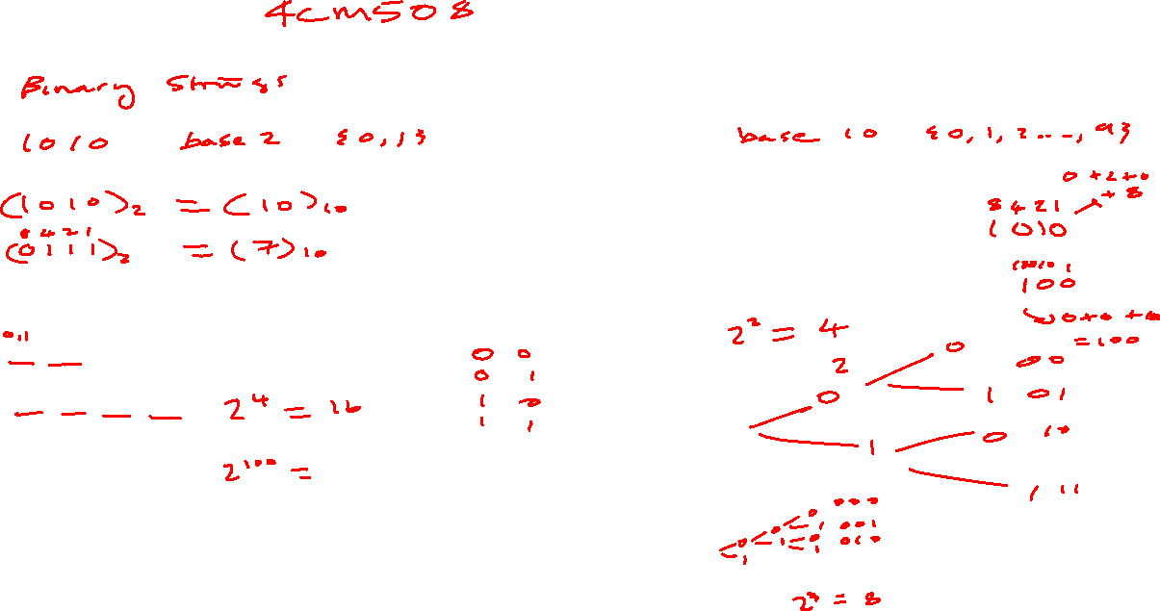
Review

Slide 2
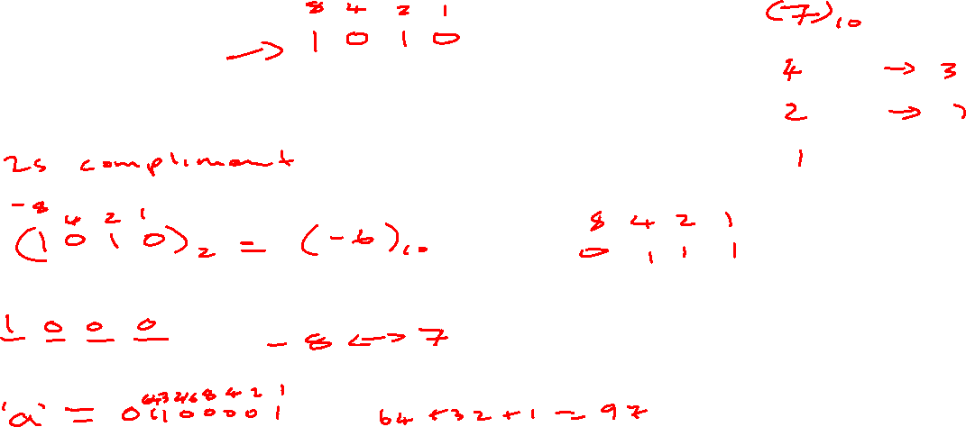

Slide 4
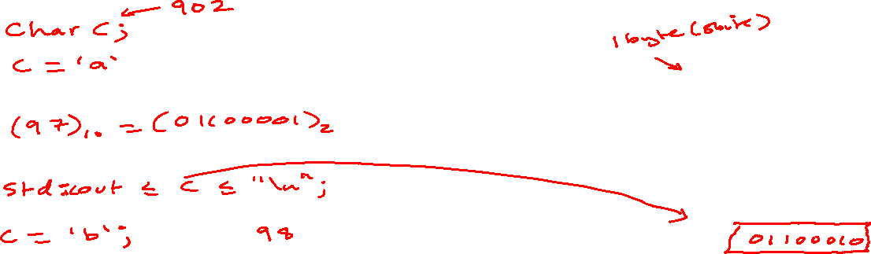
char - 1 byte (8 bits) - Ascii
Memory (RAM)
907 -
906 -
905 -
904 -
903 -
902 -
901 -
900 -
899 -
1

Slide 5
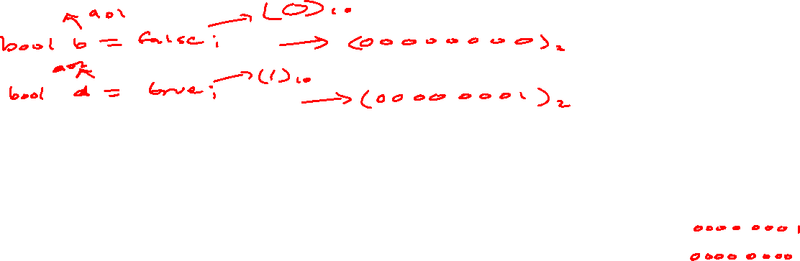
bool - 1 byte (8 bits) - true or false
Memory (RAM)
907 -
906 -
905 -
904 -
903 -
902 -
901 -
900 -
899 -
1

Slide 6
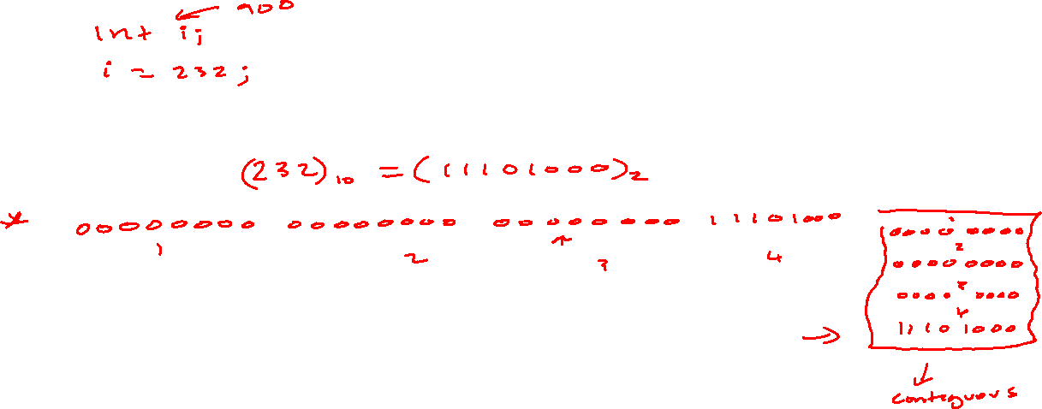
int - 4 bytes (32 bit) - 2’s complement
Memory (RAM)
907 -
906 -
905 -
904 -
903 -
0x7ffc62d6452f
902 -
0x7ffc62d6452e
901 -
0x7ffc62d6452d
900 -
0x7ffc62d6452c
899 -
1

Slide 7
Multiple data types
Memory (RAM)
907 -
906 -
905 -
904 -
903 -
902 -
901 -
900 -
899 -
1

Slide 8
float - 4 bytes (32 bit) – Single-precision
Memory (RAM)
907 -
906 -
905 -
904 -
903 -
902 -
901 -
900 -
899 -
1

